Slide 1
Under the guidance of Prof. Shatabdi Bhalerao
LOAN PREDICTION
SYSTEM
By:-
03_Zeeshan Ansari
37_Kanchan Mengune
48_Binitdev Pandey
68_Adnan Shaikh

Slide 2
INDEX
Introduction
Literature Survey
Algorithms
System Specifications
Results
Conclusion
Objectives & Design Details
1
2
3
4
5
6
7

Slide 3
Introduction
Loans are the core business of banks.
The main profit comes directly from the loan’s interest.
The loan companies grant a loan after an intensive process of verification and validation.
However, they still don’t have assurance if the applicant is able to repay the loan with no difficulties.
In this project we’ll build a predictive model to predict if an applicant is able to repay the lending company or not.
We will prepare the data using Jupyter Notebook and use various models to predict the target variable.

Slide 4
Literature Survey
Loan calculation is a much-talked-about issue in the areas of banking and finance.
In recent years, it has involved more focus towards research on credit forecast and credit risk valuation.
Decision tree study by merging cardiac markers with demographic and medical features was useful to forecast mortality and sternness in patients with COVID‐19.
. Several methods have been used in invasion detection organizations, but machine learning methods are common
The result of cardiac markers probability of changing outcome predictions and the selection of good cut is evaluated with the help of receiver operating-characteristic curve method.

Slide 5
Literature Survey
Decision tree study of medical features and merging cardiac markers with demographic is seen useful for mortality and sternness in patients with SARS predictions.
Author proposed a novel sparseness attentive algorithm for theoretically acceptable weighted quantile sketch and handling sparse data for estimation learning.
The authors analysed insurance business data for disproportion distribution, In disproportion dataset of pre-processing algorithms.

Slide 6
Objectives
Data analysis .
Data preprocessing.
Measuring data correlation.
Training different models using algorithm.
Applying same models on test data set to predict unknown loan status.
Saving submission file in CSV format.

Slide 7
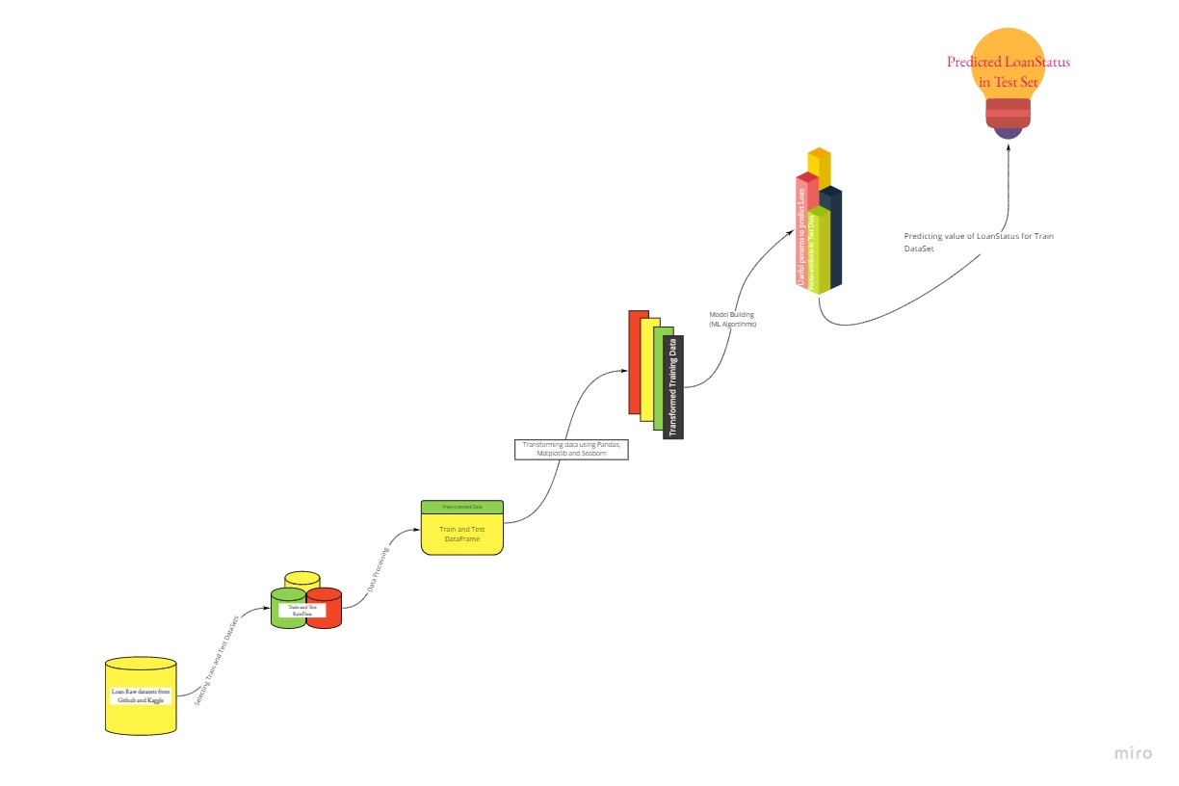
Design Details
Flowchart

Slide 8
Algorithms
Following ML Algorithms are going to be used in Loan prediction system:
1) Logistic regression.
2) Decision tree.
3) Random Forest.
4) XGBOOST
5) ADABOOSTAlgorithms are going to be used in Loan prediction

Slide 9

System Specifications :
HARDWARE SPECIFICATIONS
RAM : 8 GB+, 2700 MHz, DDR4 Minimum
Hard Drive : SSD Required
SOFTWARE SPECIFICATIONS
Anaconda 3
Jupyter Notebook
Google collab
Python 3.7
Pandas
Numpy
Seaborn
Skit-Learn

Slide 10
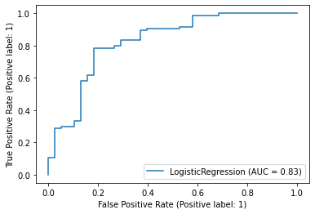
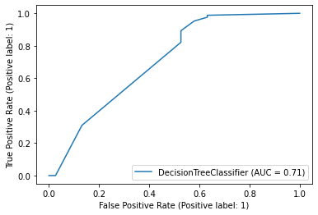
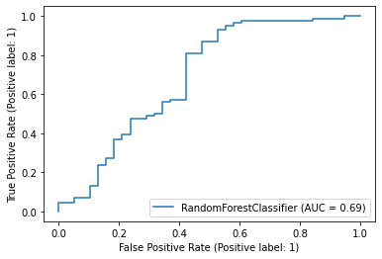
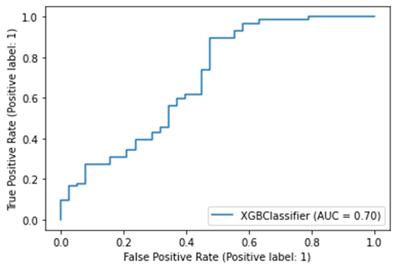
Result
1) Logistic Regression
2)Decision Tree
3) Random Forest
4) XGBoost

Slide 11
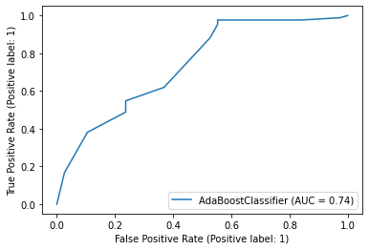
Result
5) AdaBoost
SR No. | Algorithms | Accuracy | Running Time | AUC Score
1. | Logistic Regression | 81.11% | 133ms ± 3.05ms | 0.83
2. | Decision Tree | 78% | 34ms ± 915 µs | 0.71
3. | Random Forest | 81.40% | 4.27s ± 83.2ms | 0.69
4. | XGBOOST | 76.54% | 211ms ± 10ms | 0.70
5. | ADABOOST | 81.11% | 228ms ± 5.83ms | 0.74
Table no:1

Slide 12
Conclusion
We did exploratory data Analysis on the features of this dataset and observe how each feature is distributed.
We cleaned the data and removed NA values we also generated hypothesis to prove an association among the independent variables and the Target variable.
We calculated correlation between independent variables and found that applicant income and loan amount have significant relation.
We tested the data and got the accuracy of 81 %

Slide 13


Guestrin, Tianqi Chen “XGBoost: A Scalable Tree Boosting System” research article
Weiwei lin, Ziming wu, Longxin Lin, Angzhan Wen, and Jin li “An Ensemble Random Forest Algorithm for Insurance Big Data Analysis” Digital Object Identifier 10.1109/ACCESS.2017.2738069
Sara Zahia, Boujemâa Achchab “Modeling Car Loan Prepayment” International Workshop on Statistical Methods and Artificial Intelligence (IWSMAI) April 6-9, 2020, Warsaw, Poland
Jasmin Kevric, Samed Jukic, Abdulhamit Subasi “An effective combining classifier approach using tree algorithms for network intrusion detection” springer article

Slide 14
Sara Zahia, Boujemâa Achchab “Modeling Car Loan Prepayment” International Workshop on Statistical Methods and Artificial Intelligence (IWSMAI) April 6-9, 2020, Warsaw, Poland
Jasmin Kevric, Samed Jukic, Abdulhamit Subasi “An effective combining classifier approach using tree algorithms for network intrusion detection” springer article
Eman A. Toraih, Rami M. Elshazli, Mohammad H. Hussein, Abdelaziz Elgam, Mohamed Amin, Mohammed El‐Mowafy, Mohamed El‐Mesery, Assem Ellythy, Juan Duchesne, Mary T. Killackey, Keith C. Ferdinand, Emad Kandil, Manal S. Fawzy “Association of cardiac biomarkers and comorbidities with increased mortality, severity, and cardiac injury in COVID‐19 patients: A meta‐regression and decision tree analysis” in Journal of Medical Virology · June 2020

Slide 15
Guestrin, Tianqi Chen “XGBoost: A Scalable Tree Boosting System” research article
Weiwei lin, Ziming wu, Longxin Lin, Angzhan Wen, and Jin li “An Ensemble Random Forest Algorithm for Insurance Big Data Analysis” Digital Object Identifier 10.1109/ACCESS.2017.2738069
Iftikhar Ahmaed, Mohmmad Basheri, Muhmmad Javed Iqbal, and Aneel Rahim “Performance Comparison of Support Vector Machine, Random Forest, and Extreme Learning Machine for Intrusion Detection” Digital Object Identifier 10.1109/ACCESS.2018.2841987
Robert E. Schapire “The Boosting Approach to Machine Learning an Overview” AT&T Labs Research Shannon Laboratory 180 Park Avenue, Room A203 Florham Park, NJ 07932 USA www.research.att.com/ schapire December 19, 2001

Slide 16
R. Bekkerman. The present and the future of the kdd cup competition: an outsider’s perspective.
R. Bekkerman, M. Bilenko, and J. Langford. Scaling Up Machine Learning: Parallel and Distributed Approaches. Cambridge University Press, New York, NY, USA, 2011.
J. Bennett and S. Lanning. The netflix prize. In Proceedings of the KDD Cup Workshop 2007, pages 3–6, New York, Aug. 2007.
L. Breiman. Random forests. Maching Learning, 45(1):5–32, Oct. 2001.

Slide 17
Thank You

